Slide 2
OT is under threat
Not for much longer.
Notes:
Choisir entre la slide 3 et la slide 4.
SLIDE 3 : Adaptée à une audience purement OT
SLIDE 4 : Adaptée à une audience IT/OT, institutionnelle, investisseurs

Slide 3
Critical and industrial digital infrastructures are at risk.
IT solutions simply don't work for OT!
Industrial operators are left with no choice but to rely on American, Israeli, or Asian technology.
Not for much longer.
Notes:
Choisir entre la slide 3 et la slide 4.
SLIDE 3 : Adaptée à une audience purement OT
SLIDE 4 : Adaptée à une audience IT/OT, institutionnelle, investisseurs

Slide 4
Your operations run. What about their defenses?
A well-advanced IT-OT convergence
OT is a prime target
Necessary rise in cyber maturity
Limits of current solutions
Regulatory constraints
Regulations are increasingly being applied to OT
- NIS2
- CER Directive
- Cybersecurity Act
- IEC62443
70%
Of OT systems are connected to IT networks by 2025(1)
22%
Of OT companies experienced a cyber incident in 2024(3)
86%
Of OT companies are unprepared against threats(3)
53%
Of security alerts are false positives (5)
+44%
Of OT devices exposed on the Internet over a year(2)
40%
Of those incidents caused an operational shutdown(3)
69%
Of OT companies do not have an up-to-date inventory(4)
2 to 10
Security patches to be applied monthly on an OT Firewall(6)
Telstra/Omdia – 2025
SOCRadar – 2025
SANS Institute - 2025
(4) Ponemon - 2024
(5) SentinelOne - 2025
(6) Seclab study based on the analysis of 5 vendors
Notes:
x

Slide 5
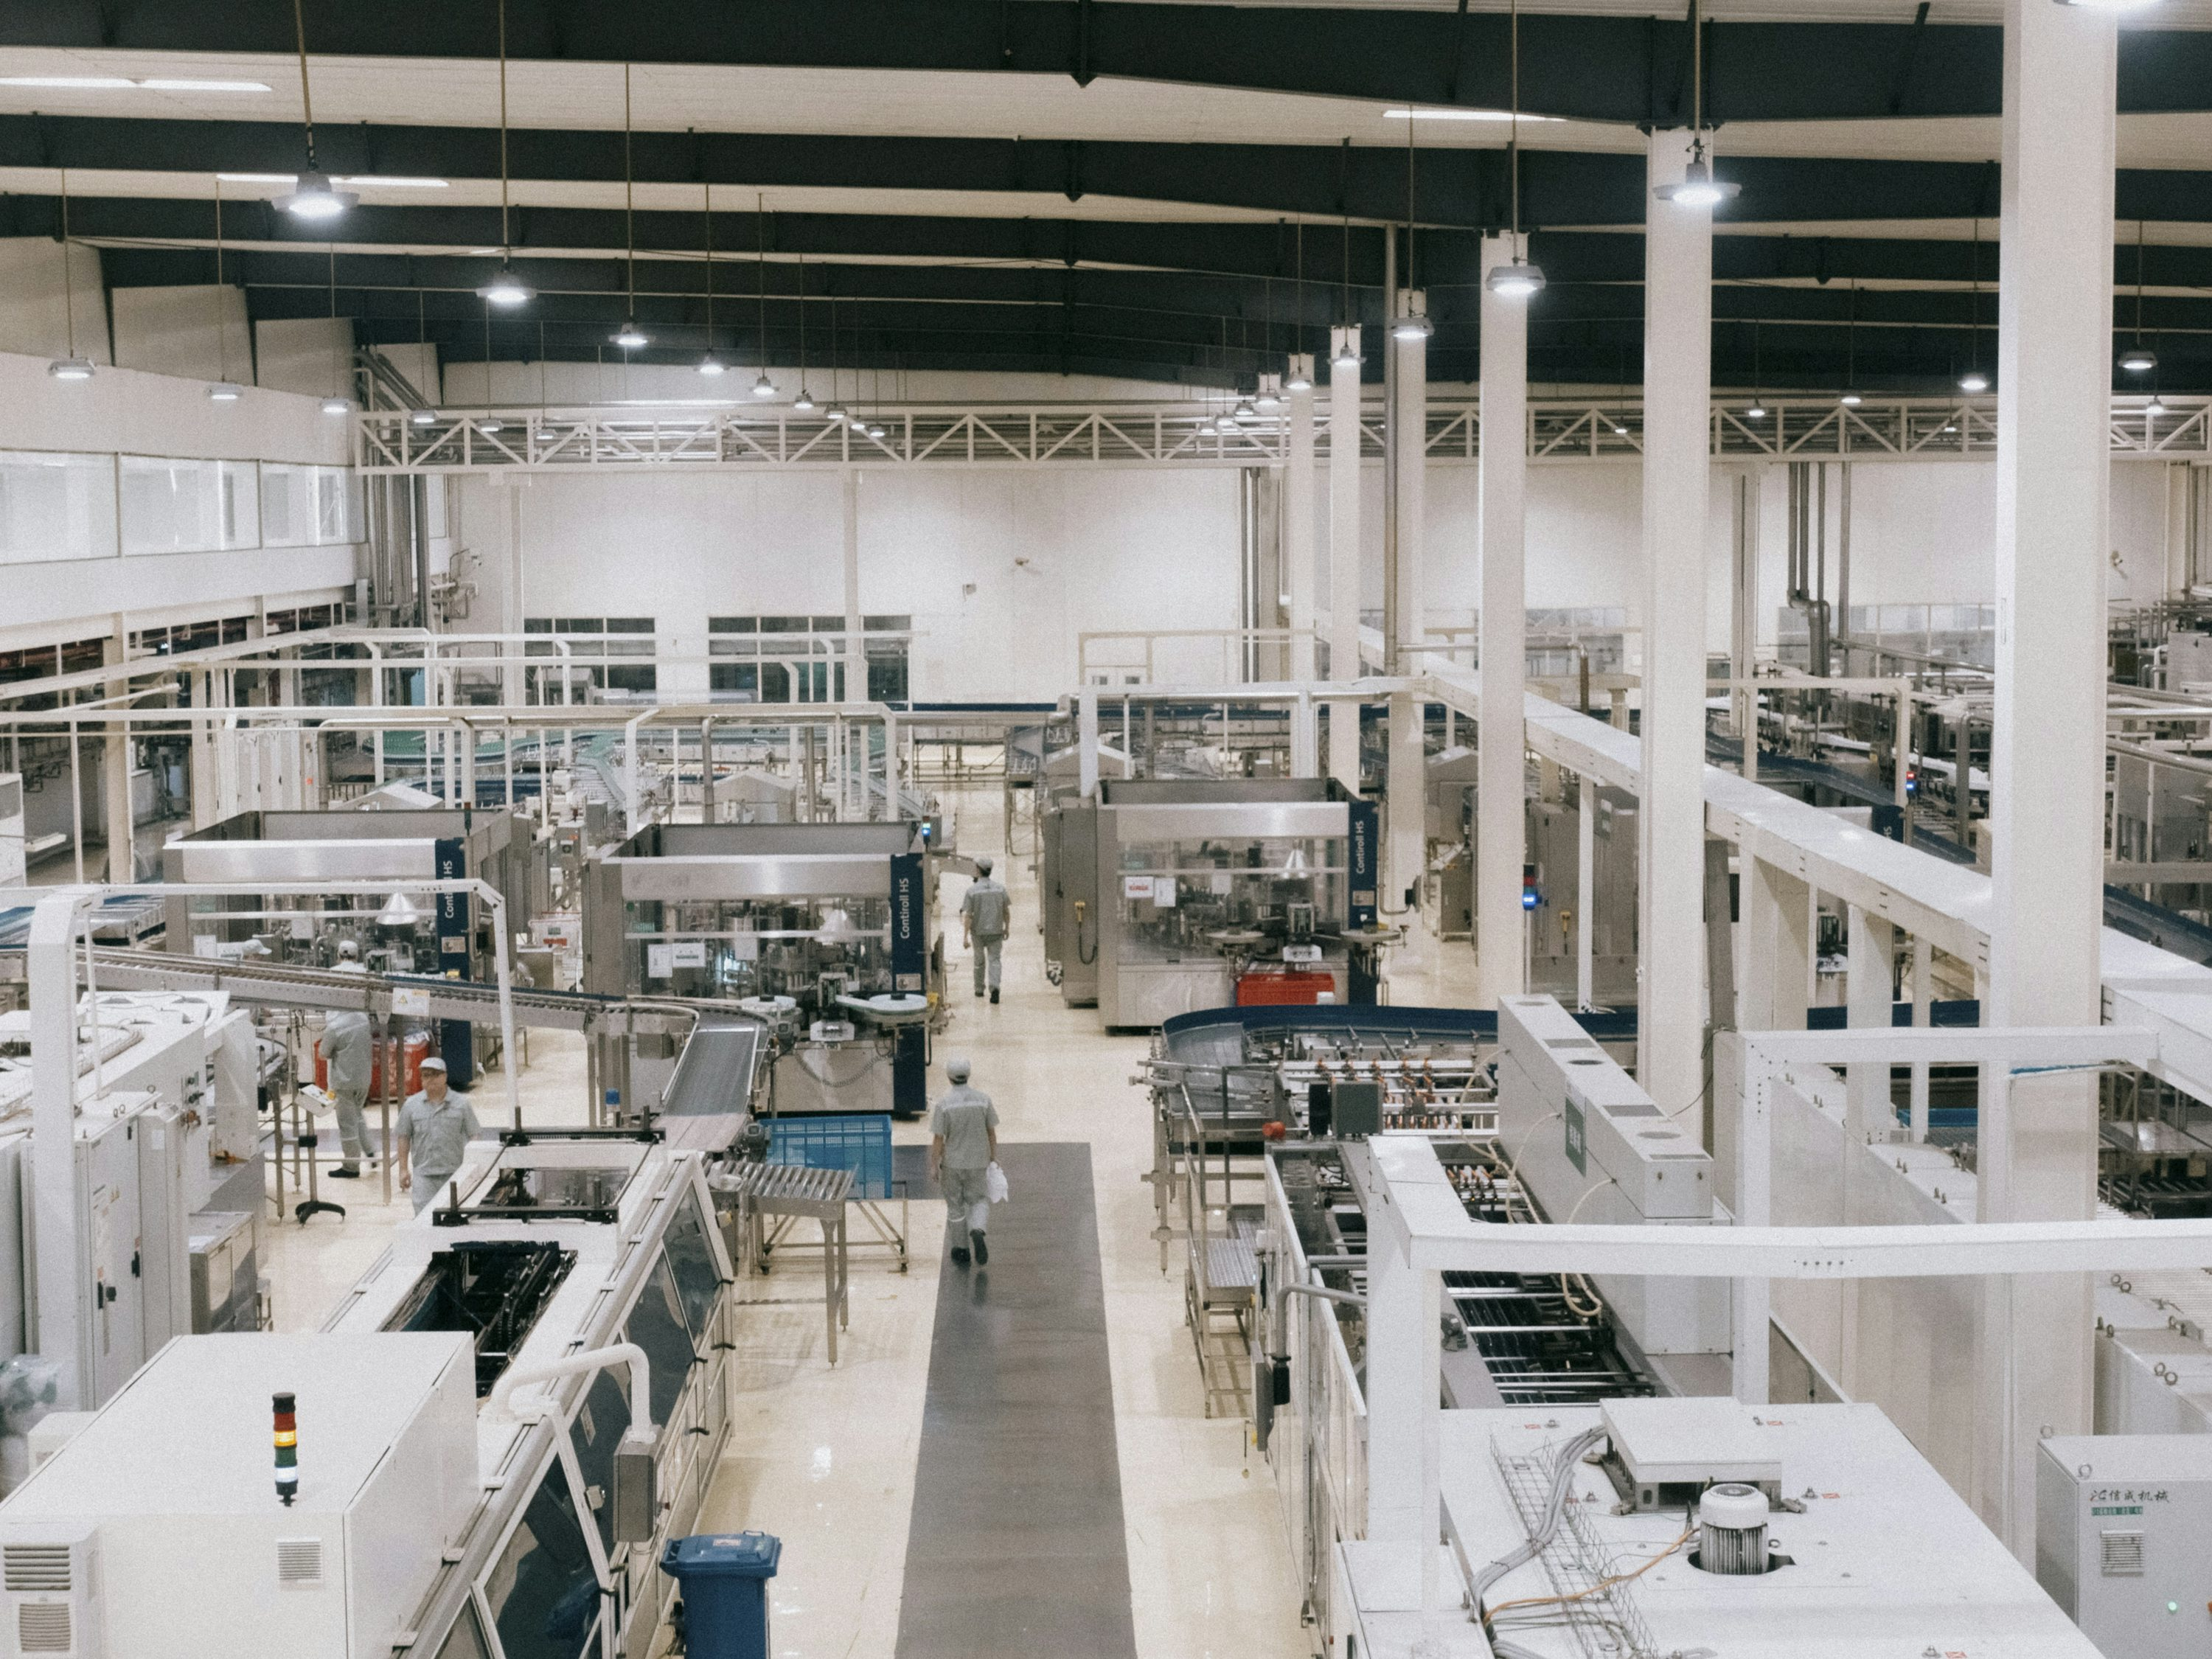

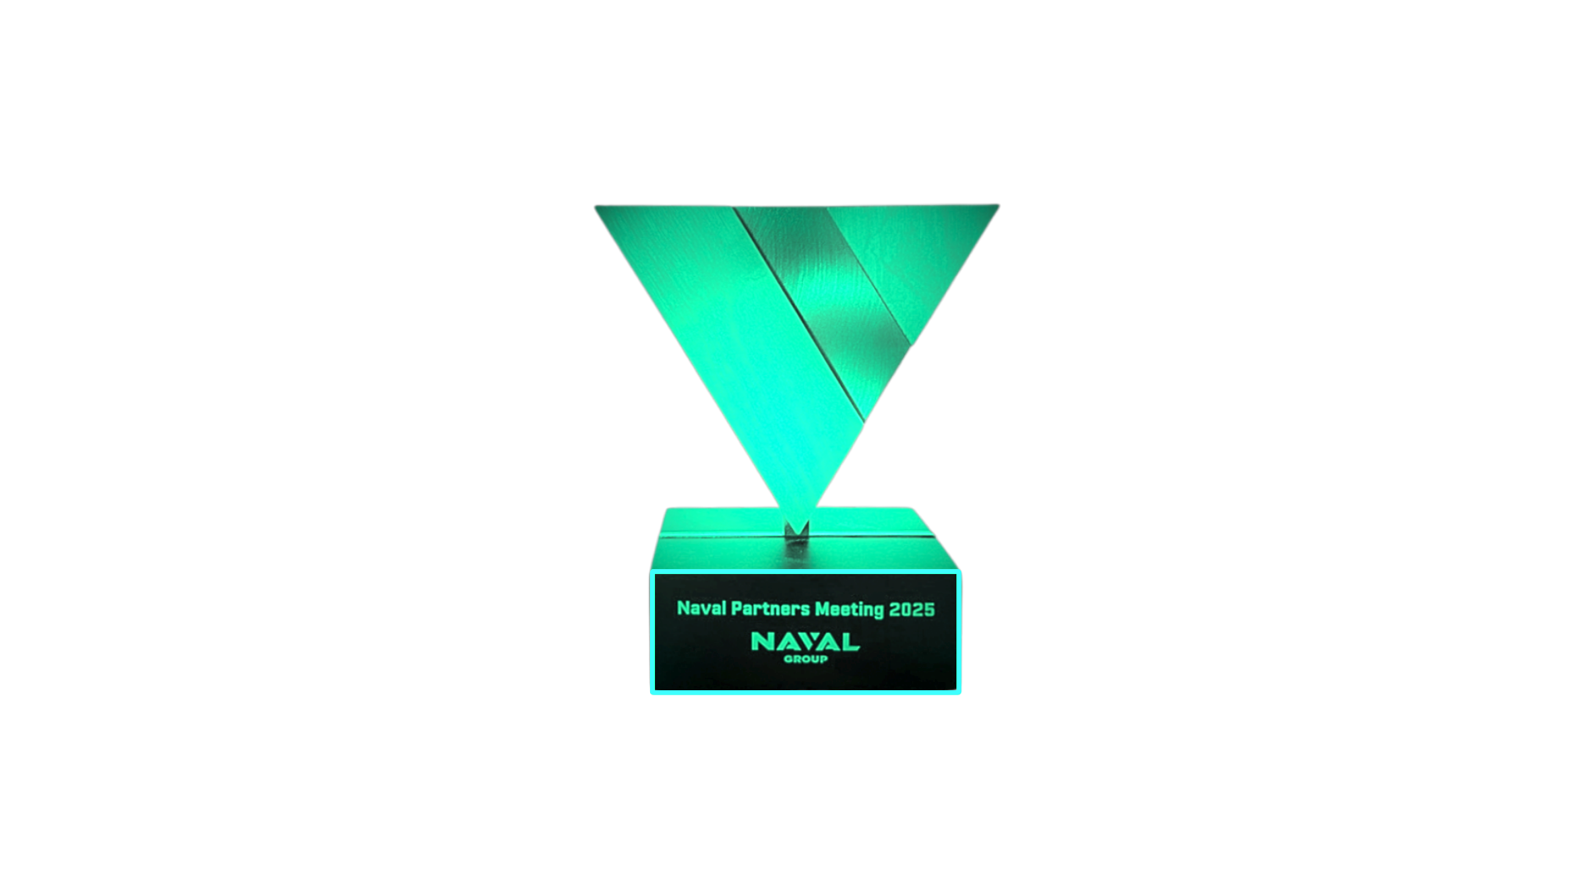
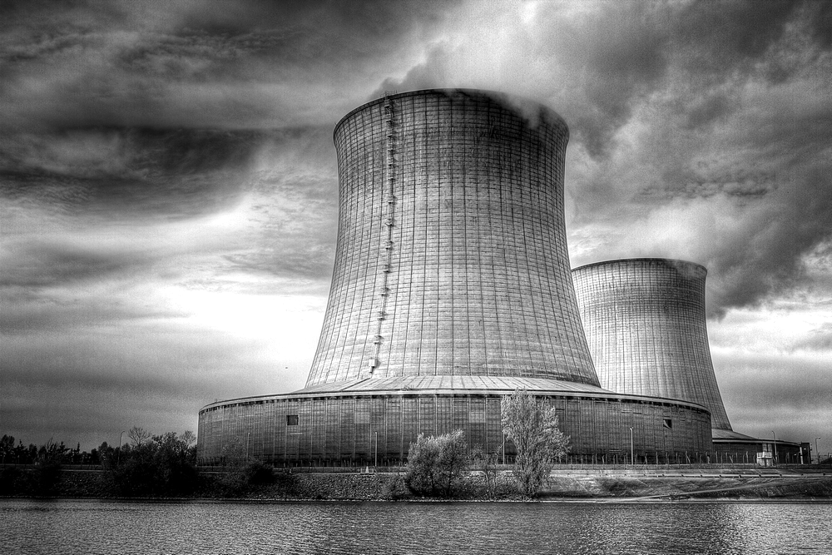


Seclab, Trust + Innovation
50
Employees
1/3
Of deployments
are international
100%
French capital
CSPN Certified
Trust
6
Patents
Innovation
Operational Excellence Award Naval Group
Certified best product for network segregation
Hardware | Embedded Software | AI

Slide 6



Endorsed by experts
” With their robust and certified products they discovered a niche at the interface of the IT and OT worlds. „
” A unique technology with an Europeen DNA, powered by a teams of security professionals who understand the security needs of the world’s most critical OT networks, differentiates SecLab from its competitors. „
” Besides blocking network cyberattacks, who may have penetrated your IT network and are carrying out reconnaissance will never be able to see any information about your OT network. „
Wam Voster, Cool Vendors in Cyber-Physical Systems Security
+ Recognized in the Gartner Hype Cycle 2025 for CPS Security and Zero-Trust Technology

Slide 7







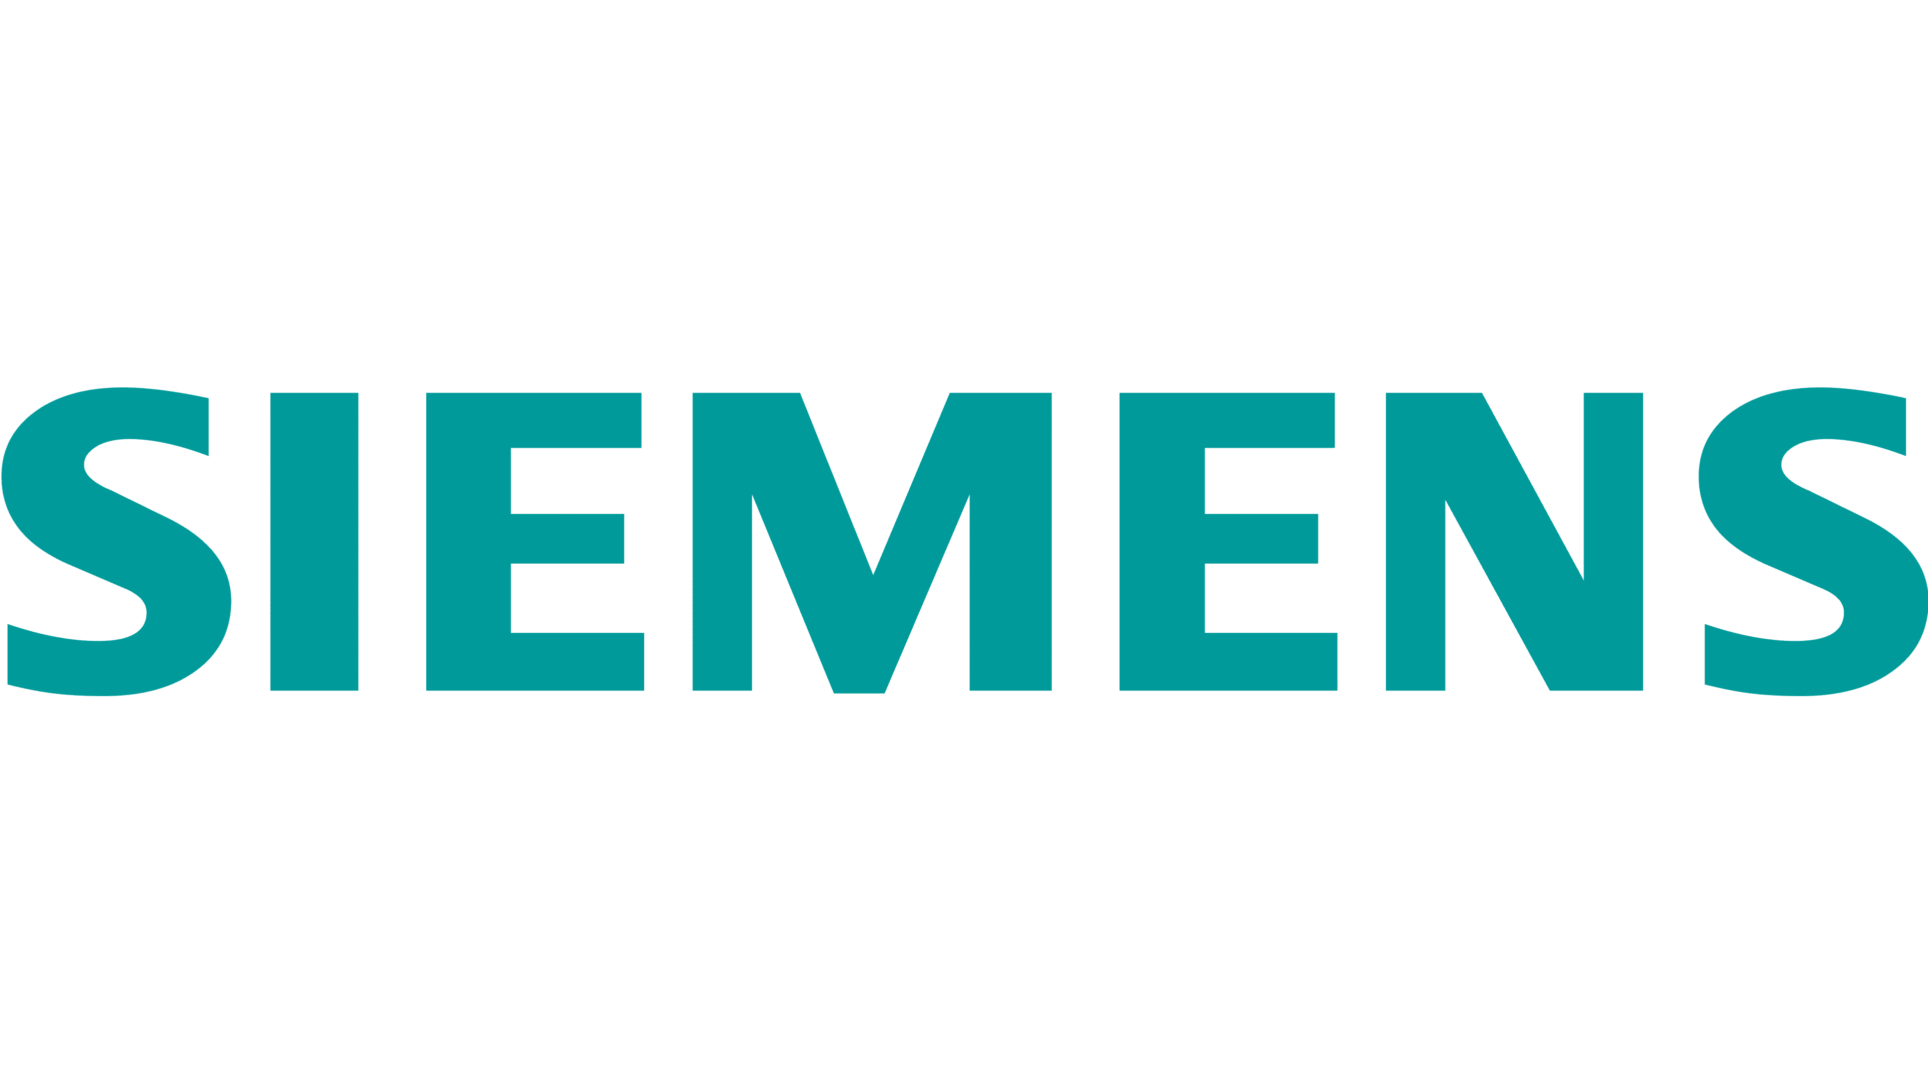





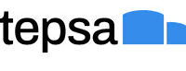







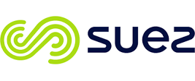


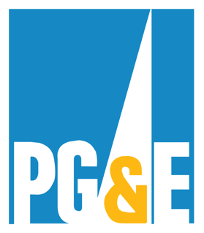
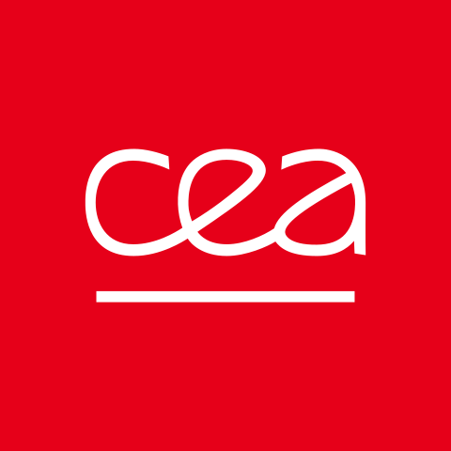
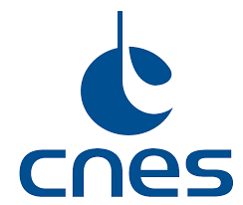











Trusted by leading organizations in OT
Industry,
Manufacturing
Transport, Logistics, Services
Energy
Public Sector,
Research
Aero, Defence, Space

Slide 8
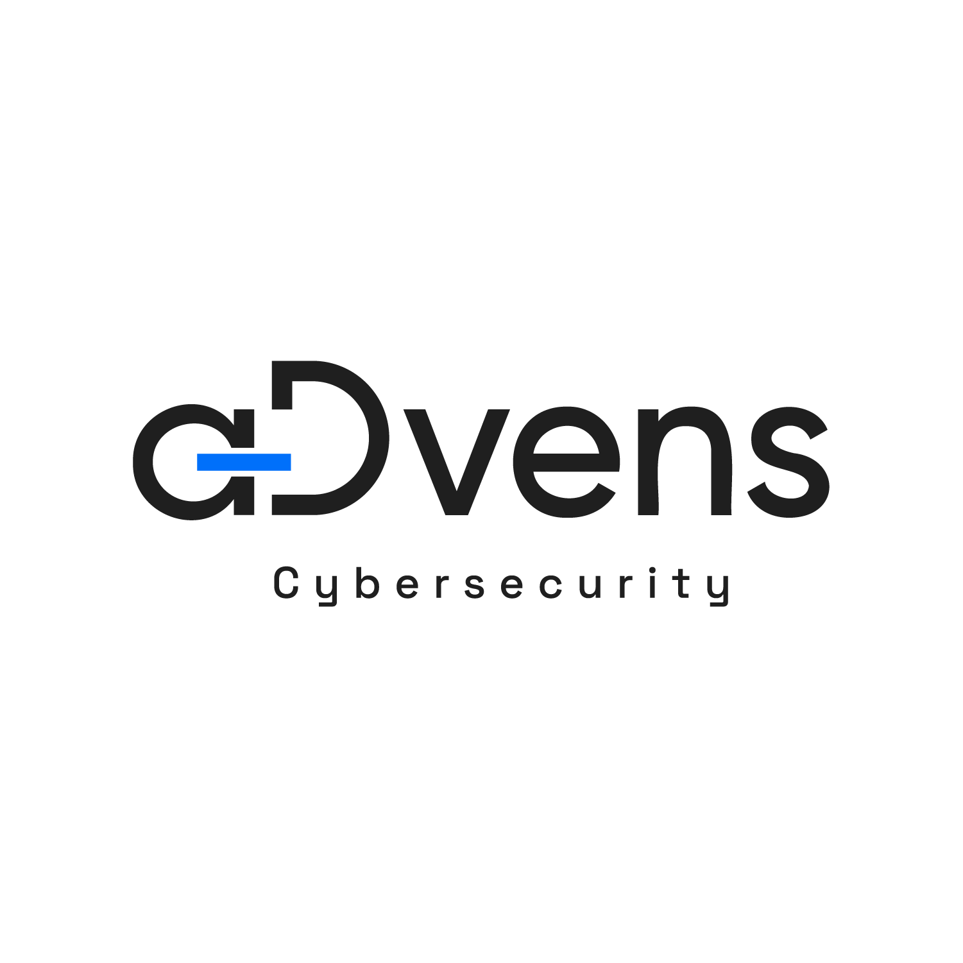




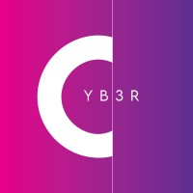







Selected by demanding partners

Slide 9
Seclab OT Cybersecurity Platform
The only CPS Protection Platform* that combines OT Infrastructure Visibility, Threat Detection and Critical Asset Protection — for true defense-in-depth.
The only European CPS Protection Platform*.
* Term used by Gartner to designate cybersecurity platforms for OT environments. CPS = Cyber-Physical Systems.

Slide 10
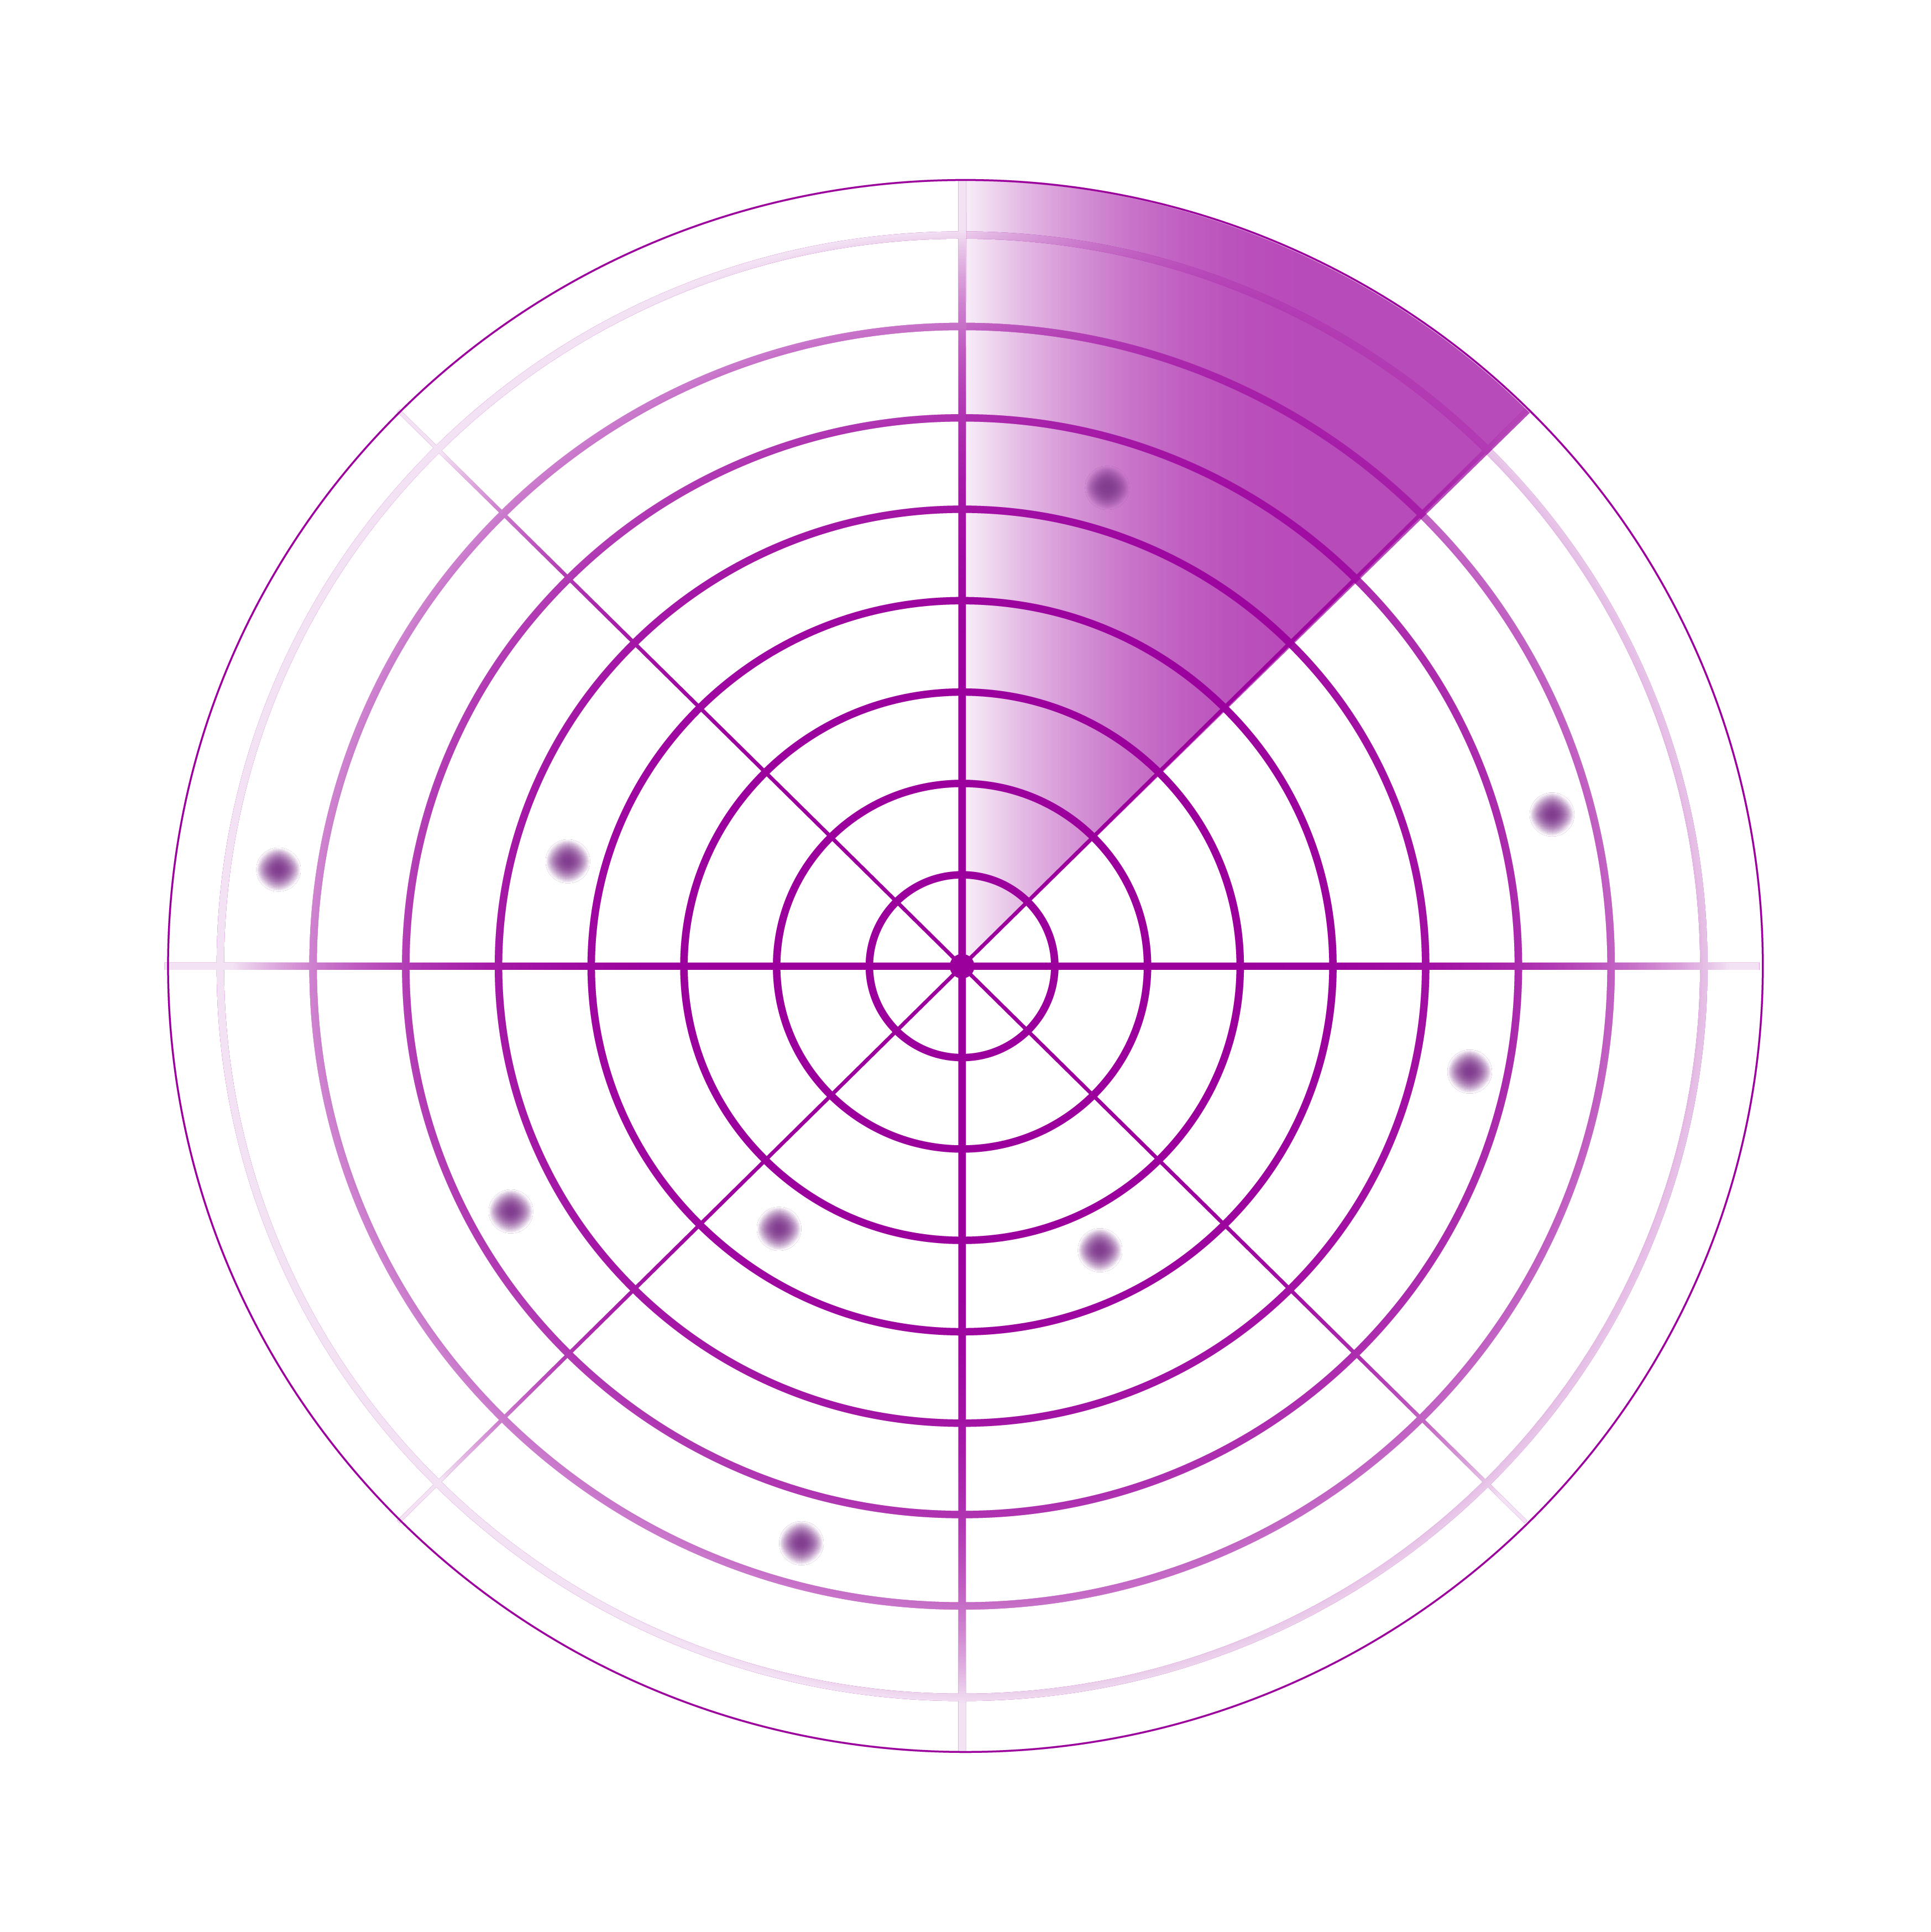
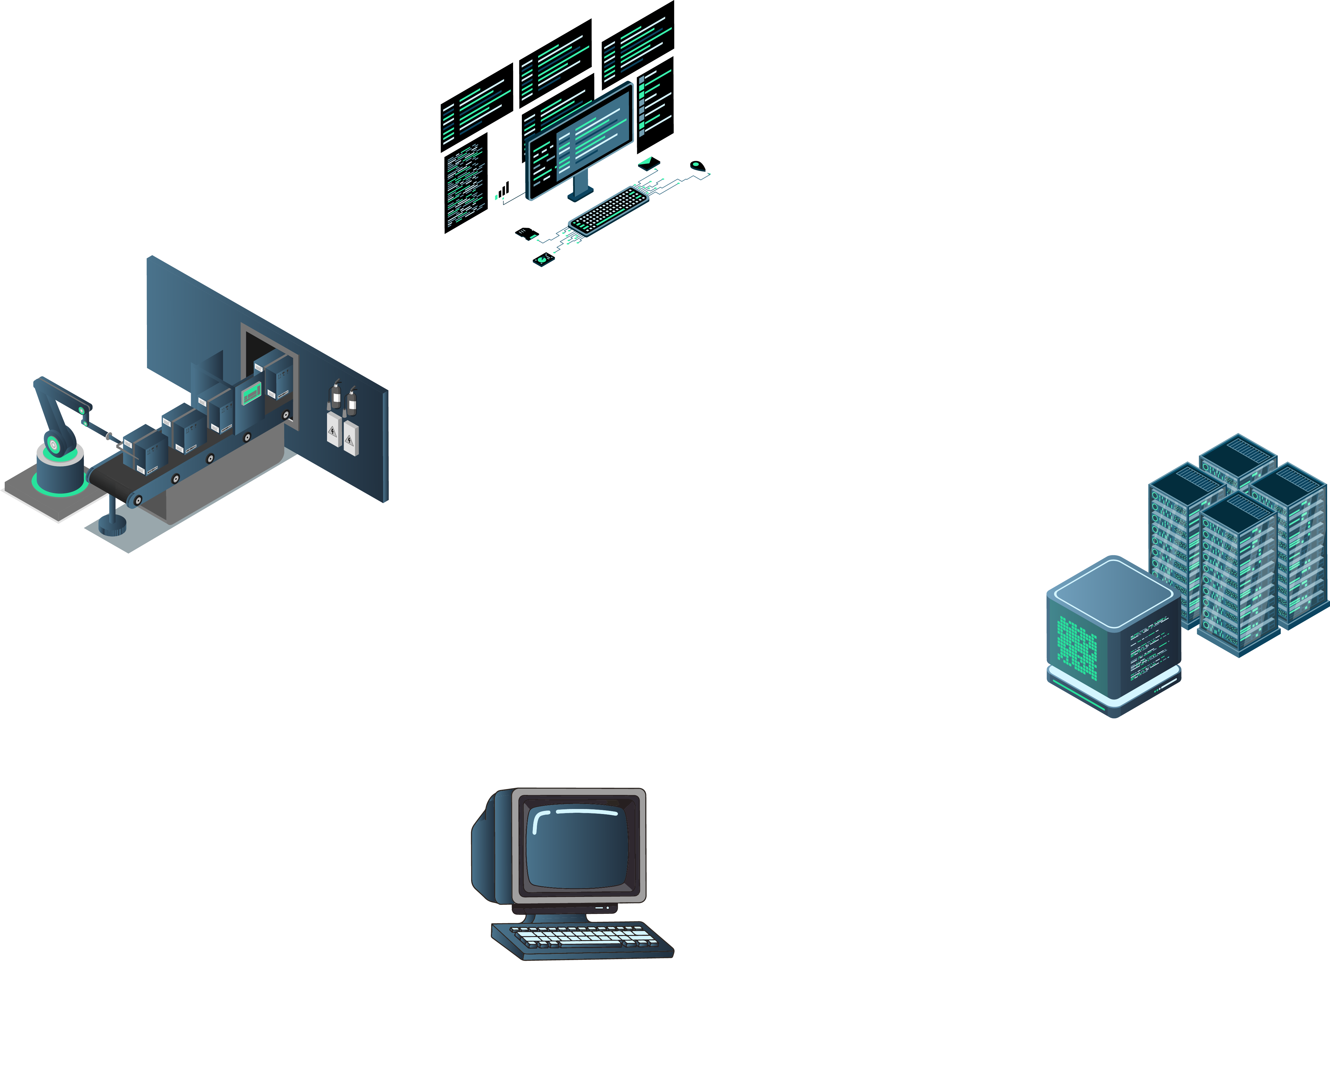
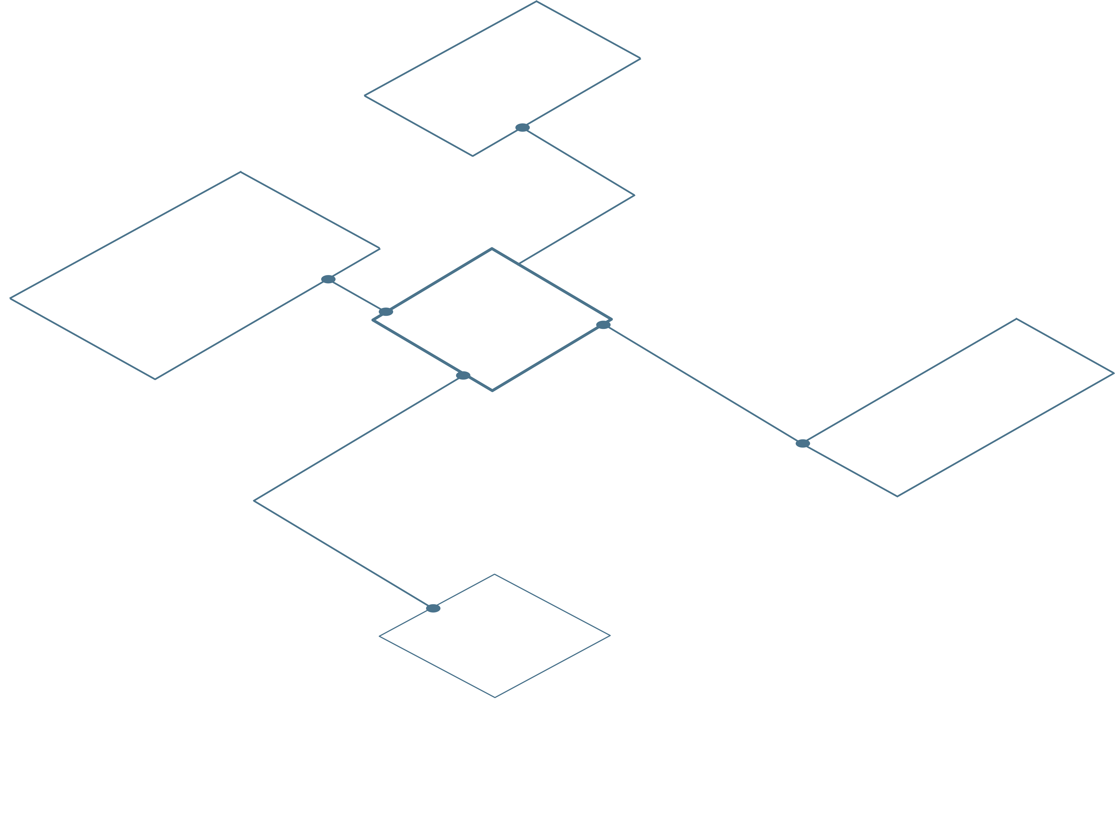

Seclab OT Cybersecurity Platform
DISCOVER
ISOLATE
DETECT
OPERATION
DESKTOPS
Building deep knowledge of the OT environment
Asset and Data Flow Discovery
Inventory and Mapping
Vulnerability Detection
Definition of Critical Assets and Authorized Flows (MVDI)
MVDI = Minimum Viable Digital Industry | Perimeter containing only the vital assets enabling business continuity

Slide 11

Seclab OT Cybersecurity Platform
DISCOVER
ISOLATE
DETECT
OPERATION
DESKTOPS
Deploying effective discovery-driven protection
Protection of critical assets (MVDI) via physical network and USB isolation (legacy or non-connected equipment) through Electronic AirGapTM
MVDI = Minimum Viable Digital Industry | Perimeter containing only the vital assets enabling business continuity

Slide 12

Seclab OT Cybersecurity Platform
DISCOVER
ISOLATE
DETECT
OPERATION
DESKTOPS
Continuously monitoring threats and anomalies
Reduced monitoring perimeter thanks to isolation
Deviation identification (new flows, assets, behaviors)
Real-time threat and anomaly detection, AI-powered

Slide 13
A step-by-step approach to secure OT
DISCOVER
ISOLATE
DETECT
Building deep knowledge of the OT environment
Deploying effective discovery-driven protection
Continuously monitoring threats and anomalies
0 | Identify all your OT assets and flows
1 | Build a comprehensive asset inventory, flow matrix, and network mapping
2 | Pinpoint vulnerabilities
3 | Define critical assets to protect (MVDI) and business flows to authorize
4 | Isolate your MVDI perimeter at the network level
4 | Secure the MVDI perimeter via USB isolation for non-connected or legacy assets
5 | Beyond MVDI, implement segmentation using standard security appliances
6 | Maintain continuous monitoring of deviations (new assets, flows, behaviors)
7 | Detect threats and anomalies in real time
8 | Adapt isolation or segmentation for mitigation
Seclab OT Maturity Response Model
MVDI = Minimum Viable Digital Industry | Perimeter containing only the vital assets required for business continuity

Slide 14

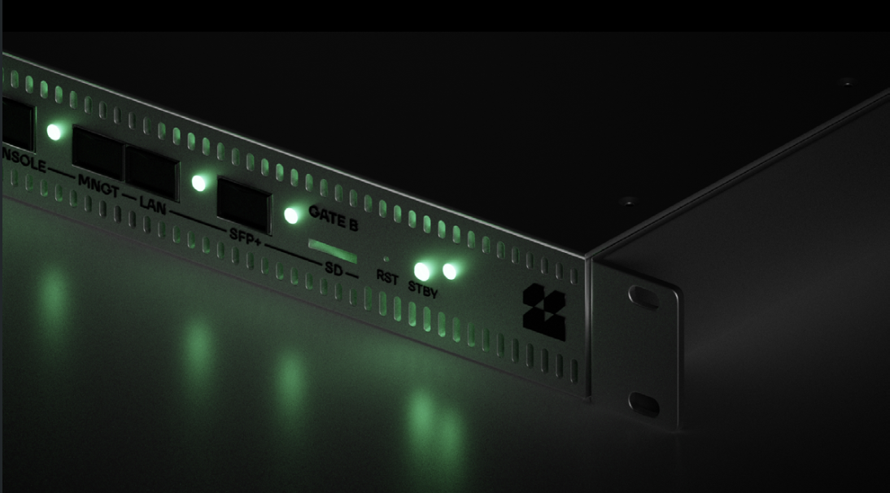
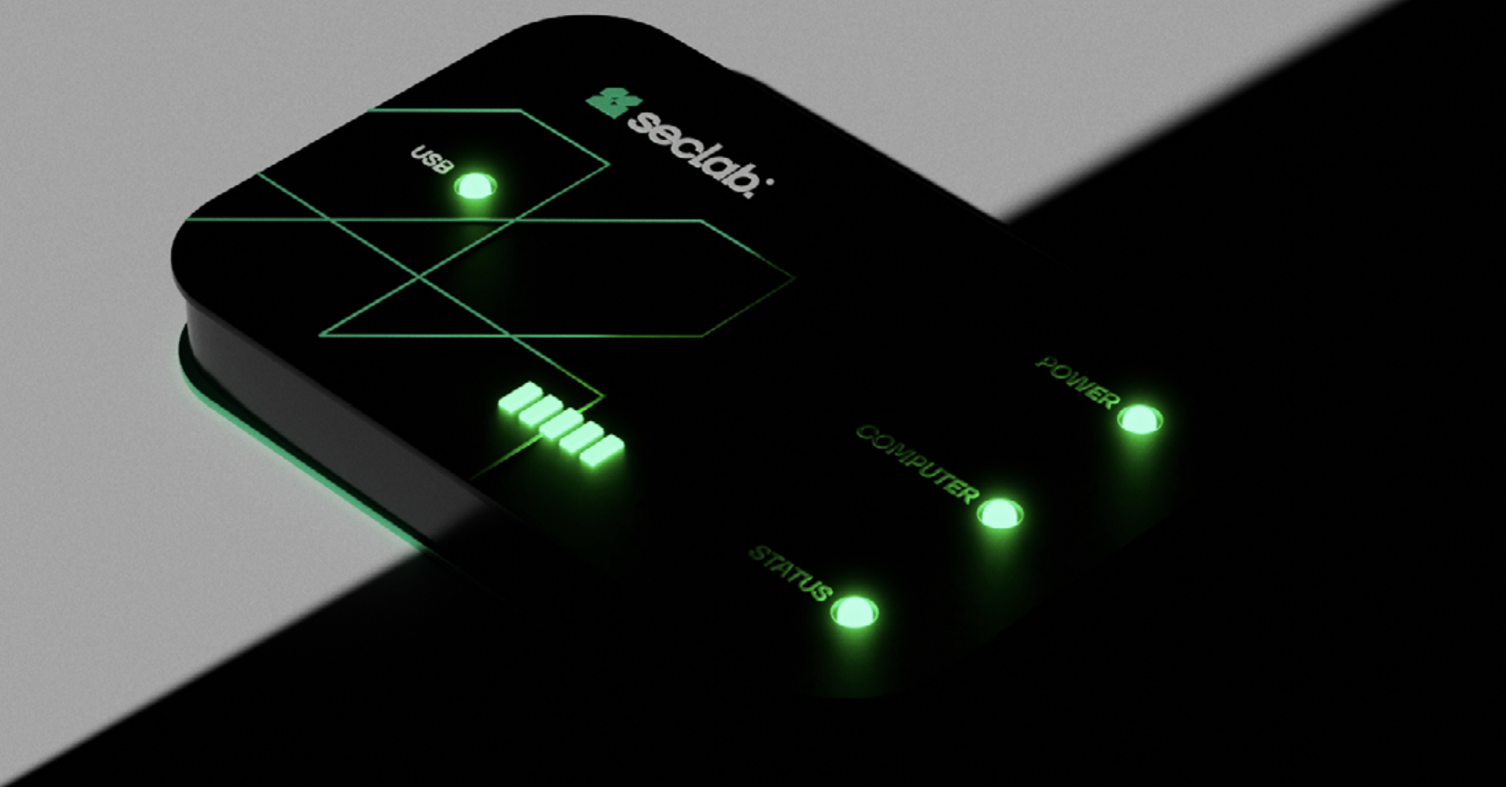
3 products for defense-in-depth
Xplore
See-First Intelligence
Xchange Network
Set-and-Forget Security
Xchange USB
Plug-and-Protect Technology
Non-intrusive OT discovery
Most comprehensive OT mapping on the market
Multiple views (Logical, Geographic, Purdue, Network/IT)
Audit or supervision mode
AI-powered threat and anomaly detection
Secure network isolation with patented Electronic AirGap
Low-latency bidirectional flows
File and application filtering
Immune to zero-day attacks
Zero patching effort
Zero-Trust administration
Secure USB isolation with patented Electronic AirGap
Bulletproof USB protection
File filtering and integrity control
Ensures operational continuity
No software installation required
Non-intrusive for legacy systems

Slide 15






Cybersecurity built for OT
Platform-driven methodological approach
= progressive maturity growth
Unified mapping combining OT and IT views
= better collaboration
Segmentation through physical isolation
= immutable security
Non-intrusive security with zero maintenance overhead
= minimal operational impact
Deviation and anomaly detection
= lower analysis overhead
Compliance by design
= peace of mind

Slide 16


Full sovereignty, control of dependencies
Across the entire development and supply chain
Selection And Purchase of Components
Assembly, Firmware Flashing, Testing and Logistics
Assistance and Technical Support
100%
European
Capital
Software
Engineering
Circuit Board Design
& Routing
Board and Chassis Manufacturing
ITAR Free
Cloud Act Free

Slide 17





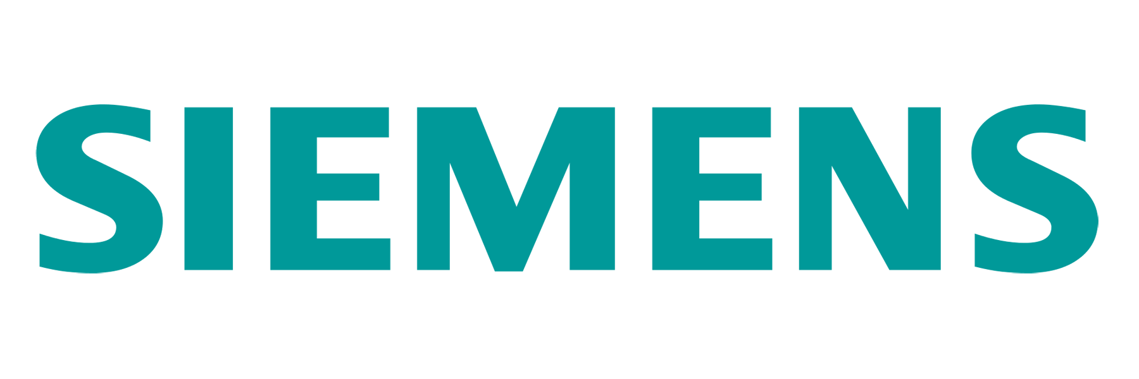






A powerful complementary ecosystem
Strategic Partnerships

Slide 18
use cases.

Slide 19
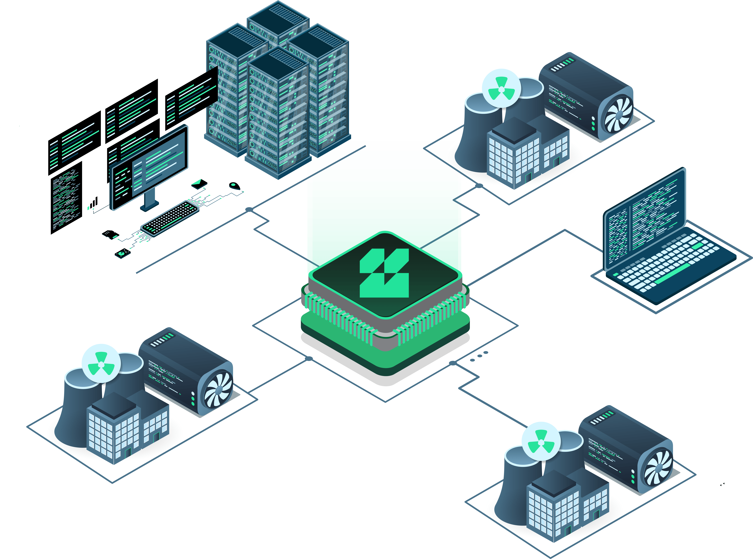


Pharmaceutical Use Case
Challenge :
Securing IT/OT flows for compliant, continuous, and resiliente production
Requirements :
Exchange production data with the IT system (quality control, R&D,…) without exposing industrial systems
Avoid any compromise of automates, user interfaces and critical equipments
Reassure the quality and compliance teams about the security of exchanges
Process :
Comparison of several technologies (fw, diode, protocol
break application/hardware)
Selected solution:
Seclab (hardware protocol break)
Customer benefits:
Physical isolation : segmentation and segregation network at 100 %
Regulatory compliance : Architecture certified CSPN by ANSSI
(French Cybersecurity Agency)
Resistant to zero-day : Attacks protection on network layers and
operating system
Long time support
Notes:
MES : logiciel de pilotage de production LIMS : logiciel de gestion de laboratoire

Slide 20
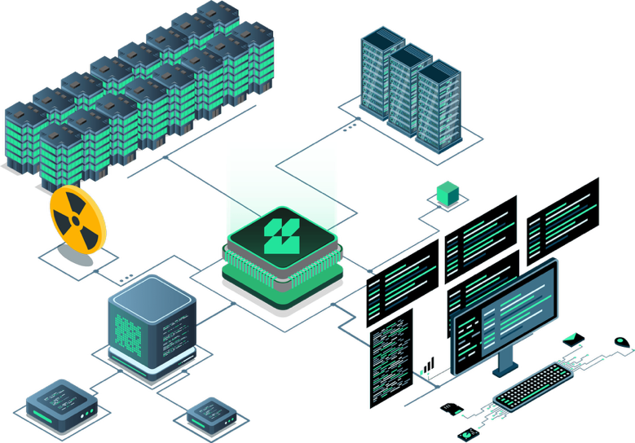
Research Use Case
Challenge :
SOC centralized management with isolated environments
Requirements :
Secured logs collection
Time synchronization between multiple IS
SOC connected with 36 isolated SI
Process :
Comparison of several technologies (fw, diode, protocol
break application/hardware)
Validation of isolation level
Collection test of logs from NDR probes and
NTP synchronization
Selected solution :
Seclab (hardware protocol break)
Customer benefits :
Bi-directional and physical isolation : SXN isolates and physically
masks the 3 environments
Regulatory Compliance : Architecture certified as compliant by ANSSI
(French Cybersecurity Agency)
Simplified administration vs a diode architecture
Governance Principle : separated responsibilities with ½ rules

Slide 21
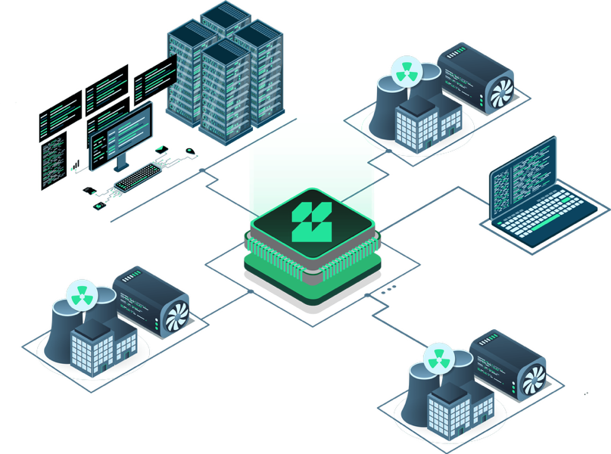
Challenge :
Digitalization of Practices
Requirements :
Protect security and reliability of critical systems while allowing system configuration and software updates
Sustain systems use that we can’t update anymore
Allow data exchange between networks from different governance models
Isolation of a nuclear power plant control center with IT
Process :
Comparison of several technologies (fw, diode, protocol
break application/hardware)
Selected solution :
Seclab (hardware protocol break)
Nuclear Use Case
Customer benefits :
Physical Isolation : segmentation and segregation network at 100 %
Regulatory compliance : Architecture certified CSPN by ANSSI
(French Cybersecurity Agency)
Resistant to zero-day : Attacks protection on network layers and
operating system
Long time support

Slide 22
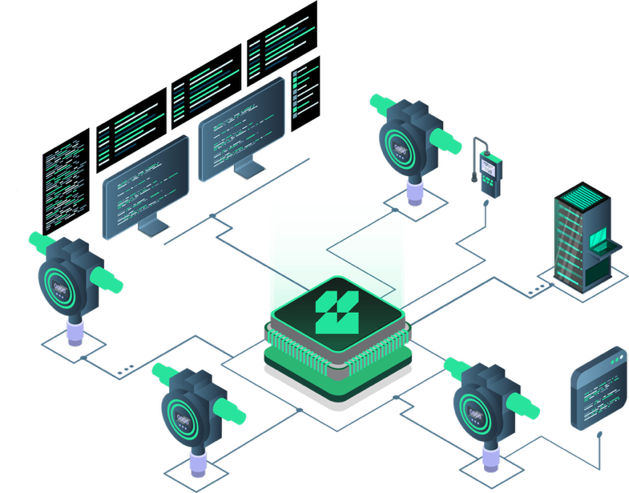
Energy Use Case
Challenge :
Digitalization of Practices
Requirements :
IT / OT interconnection
Isolation of interconnection with third parties
No latency time
Bidirectional exchanges between sensors and control center
Process :
Comparison of several technologies (fw, diode, protocol
break application/hardware)
Validation of isolation level
Latency time < 1ms
Selected solution :
Seclab (hardware protocol break)
Customer benefits :
Bi-directional and physical isolation : SXN isolates and physically
masks the 2 environments
- Regulatory compliance : Architecture certified at a cyber level and a security level
- Simplified administration vs a diode architecture
- Governance Principle : separated responsibilities with ½ rules

Slide 23
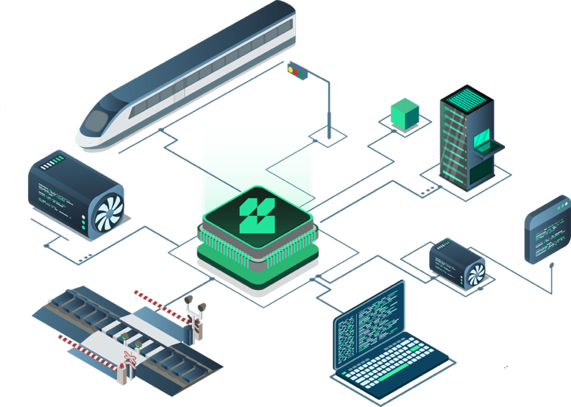
Transport Use Case
Challenges :
Digitalization of Practices & Opening to competition
Requirements :
IT / OT Interconnection
Regulatory compliance
Isolation of interconnection with third parties
Isolation between the signaling network and IT network
Process :
Comparison of several technologies (fw, diode, protocol
break application/hardware)
Validation of the security level with NATO briefcase
Functional validation of the architecture (application flows)
Selected solution :
Seclab (hardware protocol break) + Stormshield (application analysis)
Bénéfices client :
Isolation physique : SXN isole et masque physiquement les 2 environnements.
Conformité règlementaire ZEHO : Architecture certifiée conforme par l’ANSSI.
Insensible au zero-day : Pas de dépendance au correctif logiciel
Long time support
Customer benefits :
Physical isolation : SXN isolates and physically masks the 2 environments
ZEHO Regulatory Compliance : Architecture certified as compliant by ANSSI
(French Cybersecurity Agency)
Resistant to zero-day : No dependance on software patches
Long time support

Slide 24
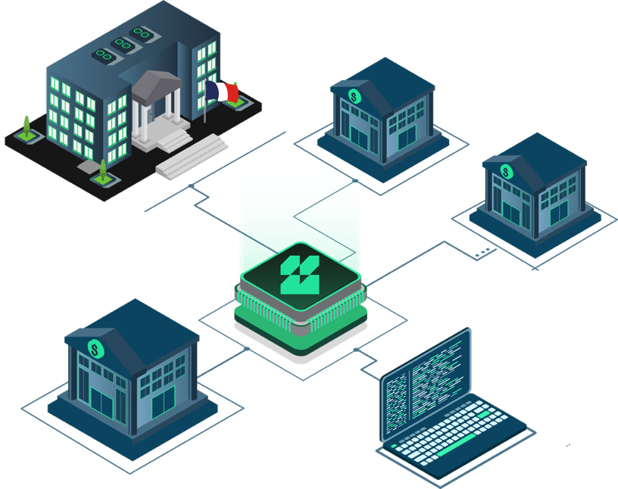
Public Ministry Use Case
Challenges :
IS controlled opening with third parties & Application isolation from intern network
Requirements :
Opening and isolation of critical application
Physical DLP
XML file exchange platform
Securing of communications TCP/IP with third parties
Process :
Comparison of several technologies (fw, diode, protocol
break application/hardware)
Validation of the security level
Functional validation of physical DLP
Selected solution :
Seclab (hardware protocol break)
Customer benefits :
Bi-directional and physical isolation : SXN isolates and physically
masks the 3 environments
Costs optimization : Protocol-agnostic solution for traversing protocols
Resistant to zero-day : No dependance on software patches

Slide 25
backup slides.

Slide 26
A new approach is needed
To be operationally effective, OT cybersecurity must:
Designed specifically for industrial and operational environments.
Speak both OT and IT — and bridge the two.
Protect, not just detect.
Be tiered — not everything needs the same level of protection.
Minimize disruption from updates and patching.
Cut management overhead and maintenance burden.
Stay ahead of future threats through disruptive technologies.

Slide 27


Electronic AirGap TM
Anti-malware
NDR, IDS/IPS …
3 independant electronic boards
External
Filtering
Network A
Internal Filtering
Network B
Admin A
½ rule
Admin B
½ rule
Electronic AirGap
0 Code
Protocol Break
Key A1
Flow 1
Key B1

Slide 28
Born from OT, built for OT
Industrial systems were never designed to be connected.
Now they are, and the threats are real. Seclab exists to close that gap.
Seclab was born in 2011 inside one of the world's most demanding environments: French nuclear energy (EDF). Originally a design office, we spent 13 years engineering software and hardware-based cybersecurity for the systems where failure is never an option — power grids, railways, space.
In 2024, a new chapter began. Acquired and reinvested by cybersecurity veterans backed by sovereign funds and Thales, Seclab scaled as an OT Cybersecurity vendor. In 2025, the company merged with Seckiot, a French startup baked by Bouygues Telecom, to build a unified CPS Protection Platform.
Our mission: give every industrial organization lasting confidence in their OT security. At the core, the Electronic AirGap, a patented, ANSSI-certified technology that physically isolates critical assets while allowing controlled data exchange. Around it, full asset visibility and AI-Augmented continuous threat or anomaly detection.
Non-intrusive. Progressive. Effortless. Built for the real world of operations.

Slide 29
Key milestones
From a Design Office dedicated to the most critical systems to
a leading hardware and software OT Cybersecurity vendor
Acquisition by
Michel Van Den Berghe
Launch of the Enterprise range
Energy Project for EDF
First prototype of the
Network Electronic AirGap
Railway Project
for SNCF
Space
Project
Extension of the
EDF Project
First Proof of Concept for
USB Electronic Air Gap
Acquisition of Seckiot
Launch of the Seclab platform
OT Cybersecurity Vendor
Design Office
2011
2015
2017
2018
2024
2025
2026
Founding of Seclab
within EDF

Slide 30
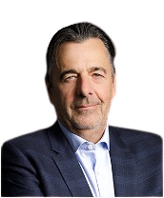

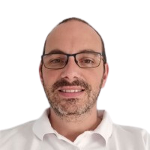

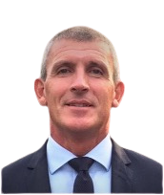
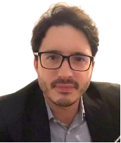
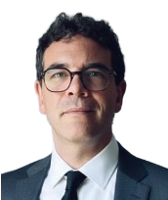
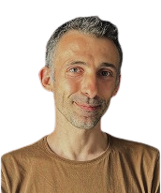
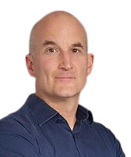
Top-grade management team
Michel Van Den Berghe
CEO
Serial Entrepreneur – former CEO
of the French Cyber Campus, Orange Cyberdefense, Atheos
Delphine Perez
Communication Director
Ex. Communication Director at
The French Cyber Campus, Orange
Cyberdefense, Atheos
François Foyer
Chief Technical Officer Software
Ex. CTO, Software Developer, Trainer at the French Ministry of Defense and Seckiot
Alexandre Garret
Deputy CEO
Ex. COO at the French Cyber Campus,
Orange Cyberdefense, Atheos
Hubert Loiseau
Chief Financial Officer
Ex. CFO, Financial controler and Partner at the French Cyber Campus, Sagemcom and KPMG
Jean-Paul Chevry
Chief Sales Officer
Ex. VP Sales and Sales Specialist at ChapsVision, Axway, Erwin, IBM and Computer Associates
Xavier Facelina
VP of Innovation & Business Dev
Co-founder of Seclab
Benoit Badrignans
Chief Technical Officer Hardware
Co-founder of Seclab
Matthieu Bonenfant
Chief Marketing Officer
Ex. CMO and Product Specialist at Woop, Stormshield, Advens, Netasq

Slide 31
100% French shareholders and leadership
€10,5M fundraising
100 % European capital
Managed by Michel Van Den Berghe
(ex. CEO Cyber Campus/Orange Cyberdefense/Atheos)

Slide 32
The gold standard in OT segmentation
Operational Capabilities | Firewalls | Data Diodes | SECLAB Electronic Isolation
Bidirectional Communication | Yes | No (with workarounds) | Yes
TCP/IP Support | Full | Limited/Proxied | Full
Encrypted Protocol Support | Full | Limited/Complex | Full
Remote Management | Yes | Limited | Yes (secured)
Application Compatibility | High | Low | High
Implementation Complexity | Moderate | High | Easy to Moderate Limitation : can’t be virtualised
Maintenance Requirements | High | Low | Very Low
Capability | Firewalls | Data Diodes | SECLAB Electronic Isolation
Threat Protection | Firewalls | Data Diodes | SECLAB Electronic Isolation
Zero-day Exploits | Vulnerable | Protected (one direction) | Protected (both directions)
Network Reconnaissance | Limited Protection | Strong Protection | Strong Protection
Lateral Movement | Limited Protection | Strong Protection | Strong Protection
Malformed Packets | Vulnerable | Protected (one direction) | Protected (both directions)
Malicious Insider | Vulnerable | Limited Protection | Strong Protection

Slide 33
Seclab – Not for defence only
Comprehensive coverage for all OT environments: Discovery, Isolation, Detection
Two isolation product lines:
Enterprise (off-the-shelf products) and Defence (purpose-built products)
Proven track record in the private sector
Defence-grade standards that directly benefit the private sector: ease of use, effectiveness, operational reliability.

Slide 34

Take back control of your geo-dependencies
Full identification of all your OT assets and their origin
Isolation to maintain control over data flows in environments subject to extraterritorial laws, enabled by dual administration
A European vendor - zero extraterritorial exposure

Slide 35
Slide to summarize
the context of a prospect

Slide 36

Title of the slide
YOUR CONTEXT
Ipsum Lorem…
Identification de tous vos actifs OT et de leur origine
Isolation pour garder la maîtrise des flux sur des périmètres soumis aux lois extraterritoriales grâce à la double administration
Fournisseur européen, sans adhérence extraterritoriale
Identification de tous vos actifs OT et de leur origine
Isolation pour garder la maîtrise des flux sur des périmètres soumis aux lois extraterritoriales grâce à la double administration
Fournisseur européen, sans adhérence extraterritoriale
Identification de tous vos actifs OT et de leur origine
Isolation pour garder la maîtrise des flux sur des périmètres soumis aux lois extraterritoriales grâce à la double administration
Fournisseur européen, sans adhérence extraterritoriale
YOUR STAKES
Ipsum Lorem…
Identification de tous vos actifs OT et de leur origine
Isolation pour garder la maîtrise des flux sur des périmètres soumis aux lois extraterritoriales grâce à la double administration
Fournisseur européen, sans adhérence extraterritoriale

Slide 37
THANK YOU

